Slide 1

Noida Institute of Engineering & Technology
Department of Computer Science and Business Systems
Session (2023-24)
Capstone Project (ACSBS0859)
Presentation on
“E-COMMERCE”
Project Guide: Submitted To: Group Members:
Ms. Garima Jain Dr. Manali Gupta Divyank Sharma(2001331560007)
D.Y Prof. CSBS Ms. Garima Jain Akhilesh Pandey(2001331560004)

Slide 2

Presentation Outline
Introduction
Literature Review
Research Gap
How to overcome Research Gap
Objectives of the Research work
Methodology
Result
Conclusion
References

Slide 3
Introduction
This e-commerce project aims to create a fully functional online shopping platform using Django.
The website will enable users to search for products, add them to their shopping cart, and complete purchases securely.
It features both user and guest checkout capabilities, accommodating a wide range of shopping preferences.
The project will integrate payment processing through PayPal to facilitate secure transactions.

Slide 4
Literature Review
Speed: Research by Li et al. (2019) underscores the significance of speed in online transactions, highlighting that users prioritize efficiency and convenience when making purchases. Guest checkout aligns with these preferences by enabling users to bypass the account creation process, resulting in faster transactions (Yoo & Gretzel, 2019). This expeditious approach resonates particularly well with time-pressed consumers who seek prompt gratification in their online shopping endeavors (Kumar & Lim, 2018).
Reduced Friction: The concept of frictionless commerce has garnered attention in academic discourse, emphasizing the importance of mitigating obstacles in the user journey (Jiang et al., 2020). Guest checkout epitomizes this ethos by eliminating the need for users to navigate through cumbersome registration forms, thereby reducing cognitive load and enhancing user satisfaction (Li & Zhang, 2021). Notably, this friction-reducing feature is especially beneficial for first-time buyers who may be apprehensive about committing to a full-fledged account setup (Choi & Mattila, 2020)

Slide 5
Research Gap
- Scalability Issues:
Many existing platforms struggle to scale effectively with increasing user load.
- Security Concerns:
Insufficient security measures can lead to vulnerabilities and data breaches.
- Customization Limitations:
Lack of flexibility to tailor the platform to specific business needs.

Slide 6
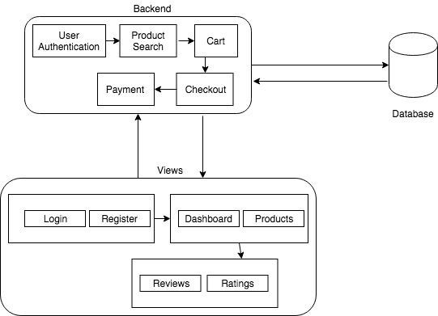
Methodology
Figure 1: System Architecture Design.

Slide 7
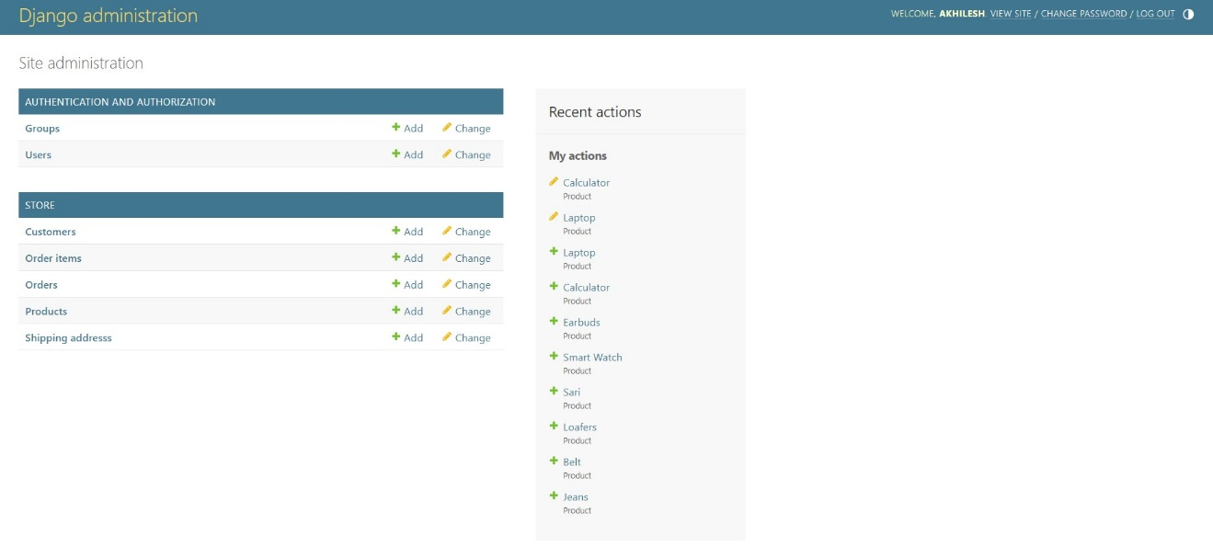
Result

Slide 8
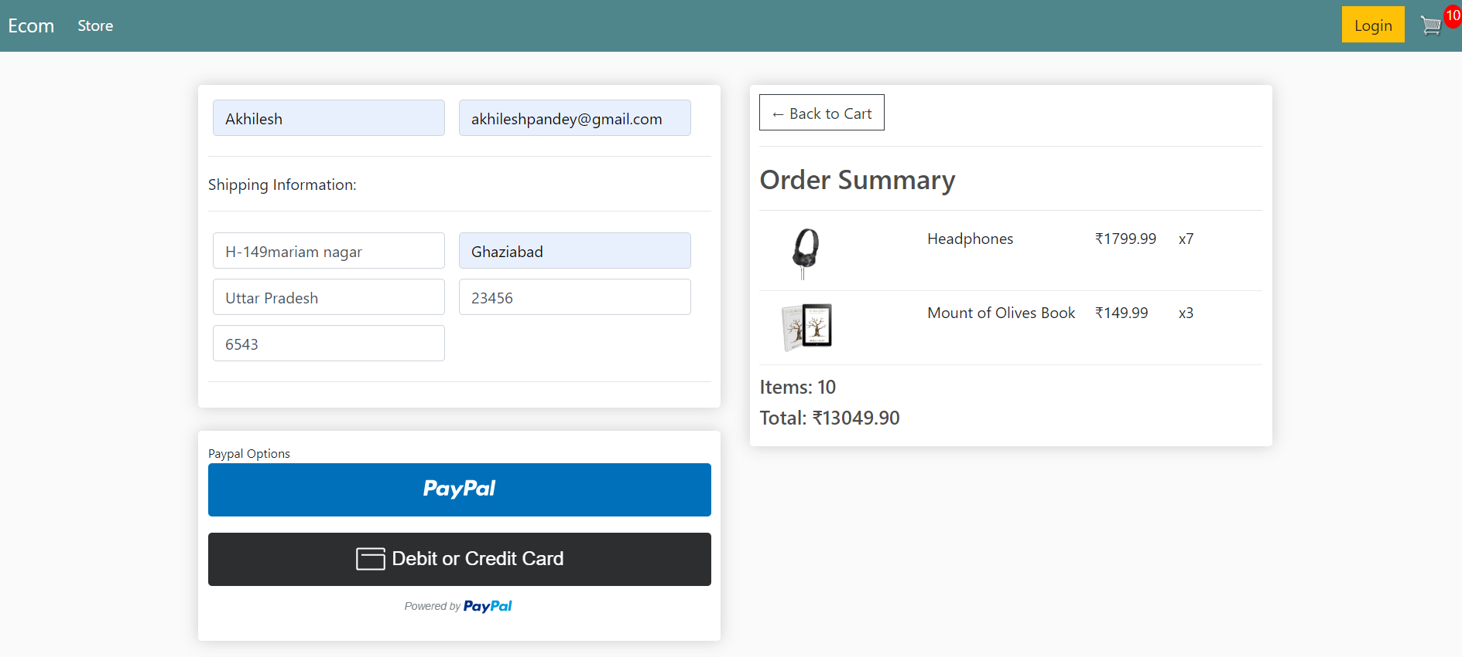
Result

Slide 9
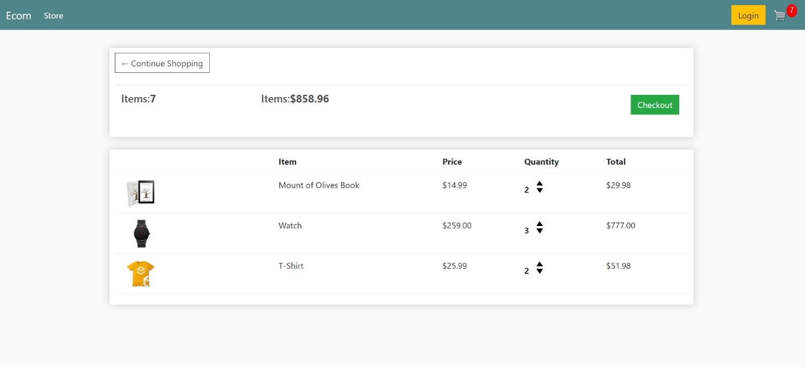
Result

Slide 10
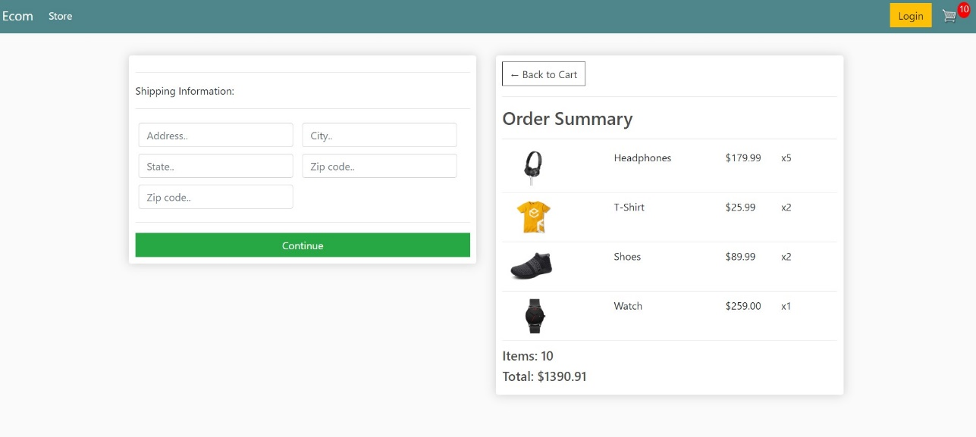
Result

Slide 11
Conclusion
1.Development and Deployment: Successfully developed and deployed an eCommerce platform using Django, providing a robust and scalable solution for online shopping. Implemented key features including user registration, product browsing, cart management, checkout, and payment integration.
2.Performance and Reliability: Maintained excellent system performance metrics, including high uptime, fast response times, and efficient load handling. Ensured data security and user privacy through robust security measures and protocol

Slide 12
References
[1] Carl Burch, Django, a web framework using Python: tutorial presentation, Journal of Computing Sciences in Colleges, Volume: 25, Issue: 5, 2010, Page: 154 – 155.
[2] Sheetal Taneja; Pratibha Gupta R, Python as a tool for web server application development, JIMS8I-International Journal of Information Communication and Computing Technology, Volume: 2, Issue: 1, 2014, Page: 77 – 83.
[3] Kavya S.L; Dr.Sarathambekai S, Python Libraries and Packages for Web Development - A Survey, International Journal of Innovative Research in Technology, Volume: 5, Issue: 12, 2019, Page: 462 – 464.
[4] Surya Teja N, A Study on Different Framework Architectures, International Journal of Innovative Research in Science, Engineering and Technology, Volume: 7, Issue: 4, April 2018, Page: 4099 – 4104.
[5] Adamya Shyam; Nitin Mukesh, A Django Based Educational Resource Sharing Website: Shreic, Journal of Scientific Research, Volume: 64, Issue: 1, 2020, Page: 238 – 252.
[6] Ahmed Yunus; Md Masum, Design and Development of an E - Commerce System in a Rapid Organized Way, International Journal of Science and Research, Volume: 9, Issue: 1, 2020, Page: 1358 – 1375.
[7] Busari O.A; Adebisi O.A; AdeagaI.I; Oni A.A, Development of an Online Shop with Python Web Framework (Django), International Journal of Advanced Research in Science, Engineering and Technology, Volume: 8, Issue:5, 2021, Page: 17293 – 17299
[8]. Nitrogen Project Website. Viewed in 2010-01-15. http://nitrogenproject. com/
[9]. OpenSourceErlang Website. Viewed in 2010-01-15. http://www.erlang. org/
[10]. Riak Project Website. Viewed in 2010-01-15. http://riak.basho.com/
[11]. Klarna Website. Viewed in 2010-01-15. http://klarna.com/
[12]. Django Project Website. Viewed in 2010-01-15. http://www.djangoproject. com

Slide 13
Noida institute of Engineering & Technology
Thank you

